Slide 1
DIFFERNCE BETWEEN VPN AND PROXY
INTRODUCTION
VPN PROXY
Secures all network Secures selected
traffic network traffic

Slide 2
VPN
PROXY
Works on an operating
System[It redirects all your
traffic, browser data or
background application data]
Traffic runs through an
encripted tunnel
Hides the user’s IP address
and location
Works on an application
system level[Reroutes the
traffic coming from a single
application you set your
proxy with]
Acts as a gateway between
users and the internet
Only hides IP address

Slide 3
VPN PROXY
It uses end-to-end
encription so that a
router or an ISP can’t
access the user’s data
With the right
technology and
maintenance protocols
there are barely any delays
No end-to-end
encription
Connection speed is
slow especially if one is
using free or popular
proxy connection

Slide 4
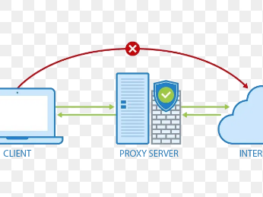
BODY[DIAGRAMS]
GENRAL DIGRAM OF A PROXY CONECTION
SOURCE ; DUCKDUCKGO

Slide 5
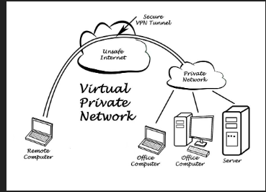
GENERAL PICTURE OF A VPN CONNECTION [source; duckduckgo]

